Slide 1
WT-411i2 & WT-454i2: service delivery, NBI model evaluation and design
Haomian Zheng, Guoxiang Liu, Aihua Guo
May, 2023

Slide 2
Background & Proposed Data Model Relationship
Use cases:
As indicated in https://wiki.broadband-forum.org/download/attachments/204472806/NPIF_411i2_Nokia_use_cases_ddd_2_6_23.pptx?version=1&modificationDate=1675695563301&api=v2 and CONTRIB-23776
Key functionalities for the NBI:
To deliver the HSI, VoIP, IPTV service, either separately or in any combinations (e.g. double-play, triple-play);
Proposed data model relationship:
Common Types in Service Delivery
Generic Service Delivery Model
HSI Delivery
VoIP Delivery
IPTV Delivery
Customized Delivery
(Optional)
Augment

Slide 3
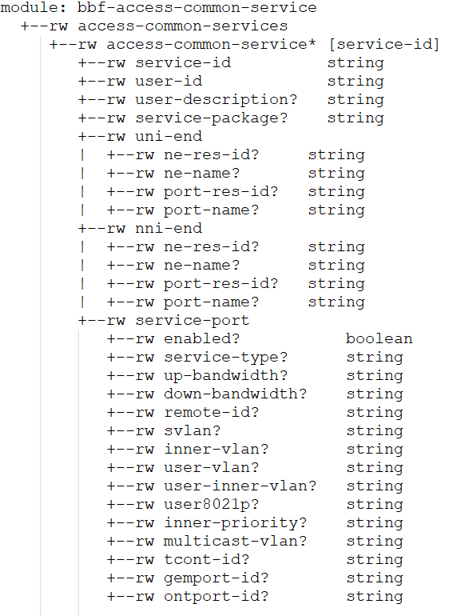
Generic Service Delivery Model
Base model for all the access service models
Defines UNI, NNI and service ports for e2e access services
Reference: TR-411, Table 4

Slide 4
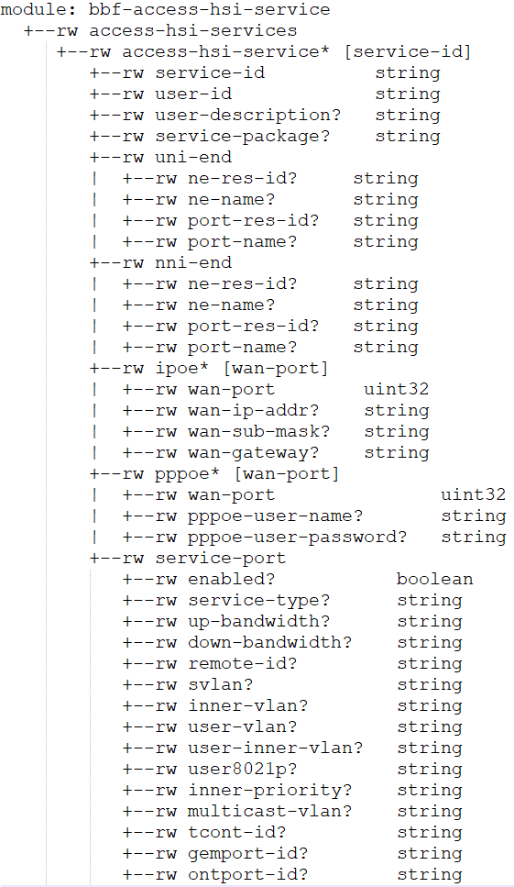
HSI Service Delivery Model
Augments from the generic service delivery model
Add:
IPoE information
PPPoE information
Reference: TR-411, Table 4

Slide 5
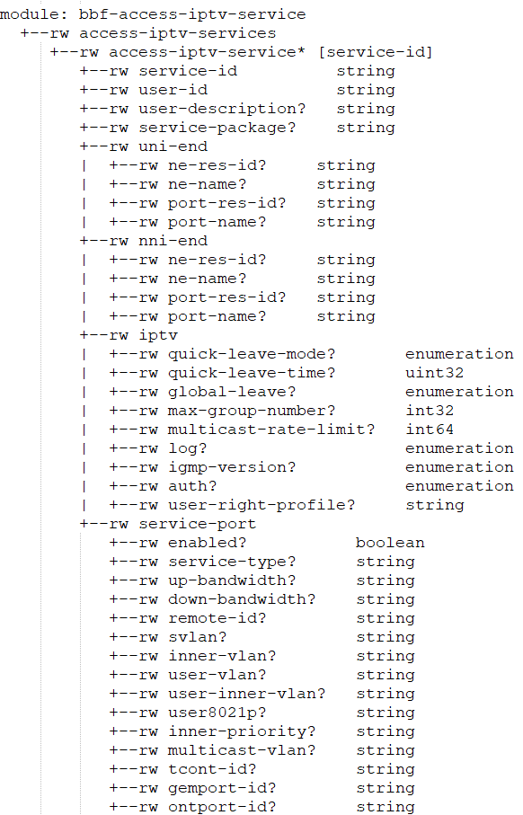
IPTV Service Delivery Model
Augments from the generic service delivery model
Add:
IPTV information
Reference: TR-411, Table 4

Slide 6
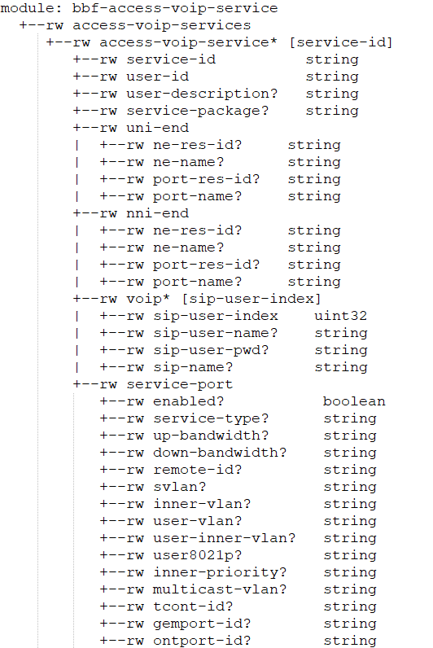
VoIP Service Delivery Model
Augments from the generic service delivery model
Add:
VoIP information
Reference: TR-411, Table 4

Slide 7
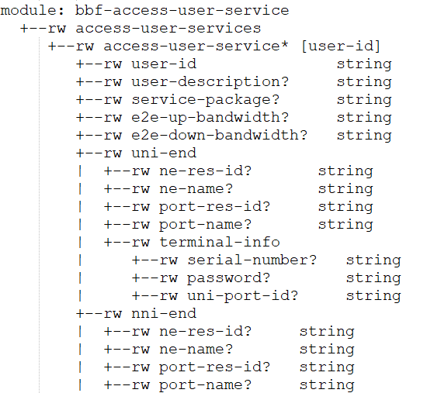
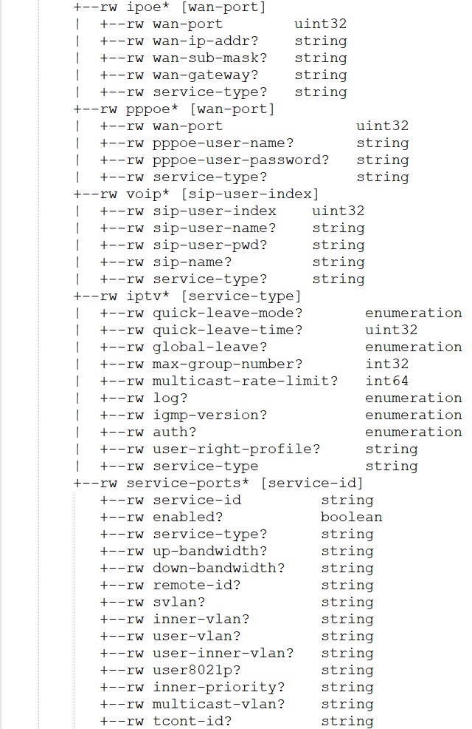
(Optional) Customized Service Delivery
Combined service delivery
Not needed if customized service delivery is handled by the OSS. Access M&C only deals with element service delivery
Augments from the generic service delivery model

Slide 8
Summary
TBD

